Slide 1
Mechanics
Design
Smart - Convenience - Comfortable

Slide 2
Scan
Body

Slide 3
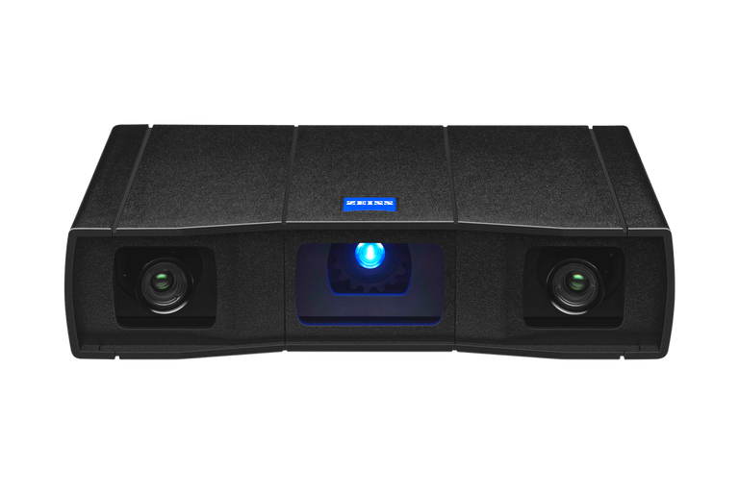
GOM SCAN 1

Slide 4


Slide 5
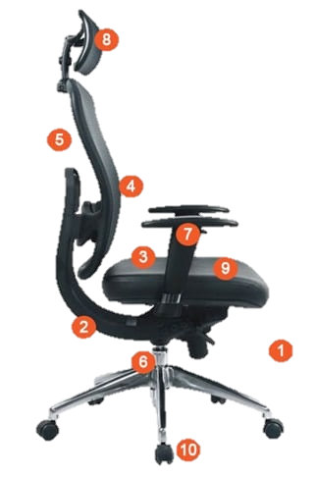
Headrest
Backrest recline
Backrest Lumbar support
Armrests
Seat tilt
Materials
Seat width and depth
Seat height
Swivel
Wheels

Slide 7
Traction
Here's how we're growing.
40
30
20
10
0
Item 1
Item 2
Item 3
Item 4

Slide 8


Who are our shoppers?
Both our Grocery and Retail business models have their own target markets.
Heads of families
Individual shoppers
They can use StorX Shopping for precise and real-time grocery shopping without leaving the house.
They can use StorX Shopping to buy and inspect items in-store before making their final purchase.

Slide 9
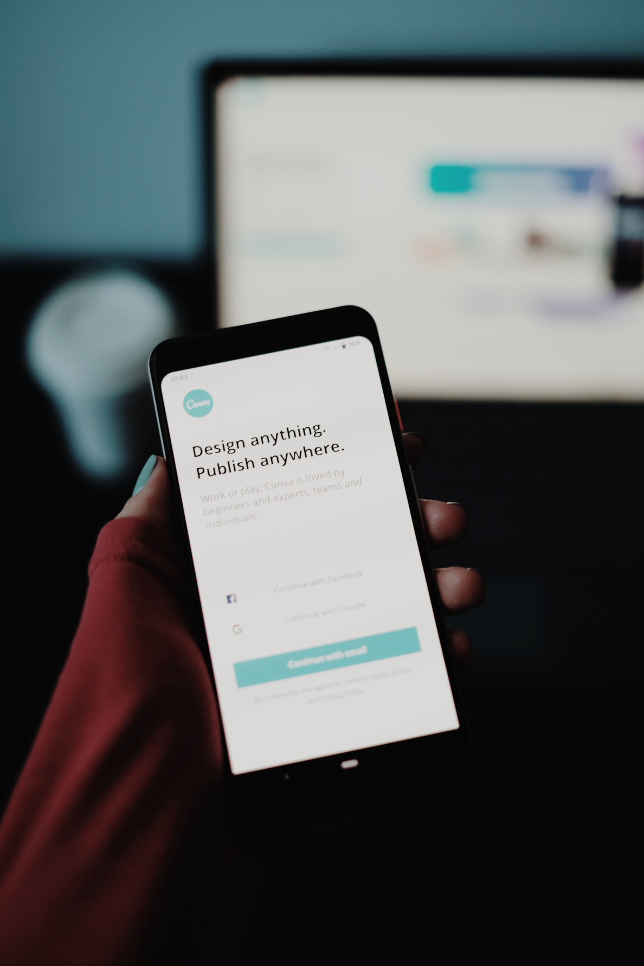
Market Size
1.9 Billion
TOTAL AVAILABLE MARKET
53 M
SERVICEABLE AVAILABLE MARKET
10 M
MARKET SHARE

Slide 10
Indirect Competitors
Direct Competitors
BiggsBaggs E-Shopping
Baxx Clothing Co.
RentaShoppe Online
XRS Superstore Online
iGrouu Delivery Group
Addazzel Corp.

Slide 11

Competitive Advantages

Slide 12
Cutting-edge technology
Our video streaming option makes use of VR and AR technologies.
Partnerships with major brands
We have non-compete deals with major
department stores.
Easy to use
People can easily sign up as a customer or a dedicated shopping partner.
Social responsibility
We offer free services for seniors and people who are differently-abled.

Slide 13
Competitor Approach
Develop technologies
Shopping is for everyone
Expand Brand Partners
We want to make it extremely easy for customers and delivery partners to sign up with our service.
Lock down exclusive deals with brands and companies as their official remote shopping partner.
New technologies will always be the backbone of our operations.

Slide 14
Our Business Model
These are tier plans we plan to offer our clients.
ONE-TIME PAYMENT
For customers who only need to use our services once.
MONTHLY SUBSCRIPTION (INDIVIDUAL PLAN)
For customers who want a dedicated shopper for their retail needs.
MONTHLY SUBSCRIPTION (FAMILY PLAN)
For customers who want a dedicated shopper for their grocery needs--available for every member of the family.

Slide 15



Meet the Team
CAHAYA DEWI
HARUMI KOBAYASHI
YANIS PETROS
Chief Executive Officer
Chief of Operations
Chief Product Officer

Slide 16
Future Roadmap
2025
Series B Funding
This is where we're headed.
2027
Series C Funding
2028
Private Funding

Slide 17




Contact Us
123-456-7890
HELLO@REALLYGREATSITE.COM
WWW.REALLYGREATSITE.COM

Slide 18



















Free Resources
Use these free recolorable icons and illustrations in your Canva design

